Slide 1


Group 1
Project presentation
Phytoplankton Air Systems
Dhairya Pal (N01576099)
Julian Imperial (N01638310)
Dharmik Shah (N01581796)
Sanskriti Mansotra (N01523183)
Algaerithms Inc.

Slide 2








Sanskriti M.
Dhairya P.
Scrum Master & Developer
Team Lead & Developer
Dharmik S.
Julian I.
Lead Developer & Database Manager
Developer & Agile Support

Slide 3
Hardware Architecture – Phytoplankton Air System
Air Quality Sensor: Measures overall air quality levels inside the enclosure to support system monitoring.
Light Sensor: Detects light intensity and environmental brightness for phytoplankton growth conditions.
Proximity Sensor: Registers nearby motion or user interaction for system responses.
Turbidity Sensor: Assesses water clarity and phytoplankton density in the chamber.
Custom PCB + Raspberry Pi 4: Consolidates all sensor connections, reduces wiring errors, improves durability, and powers the entire system.

Slide 4
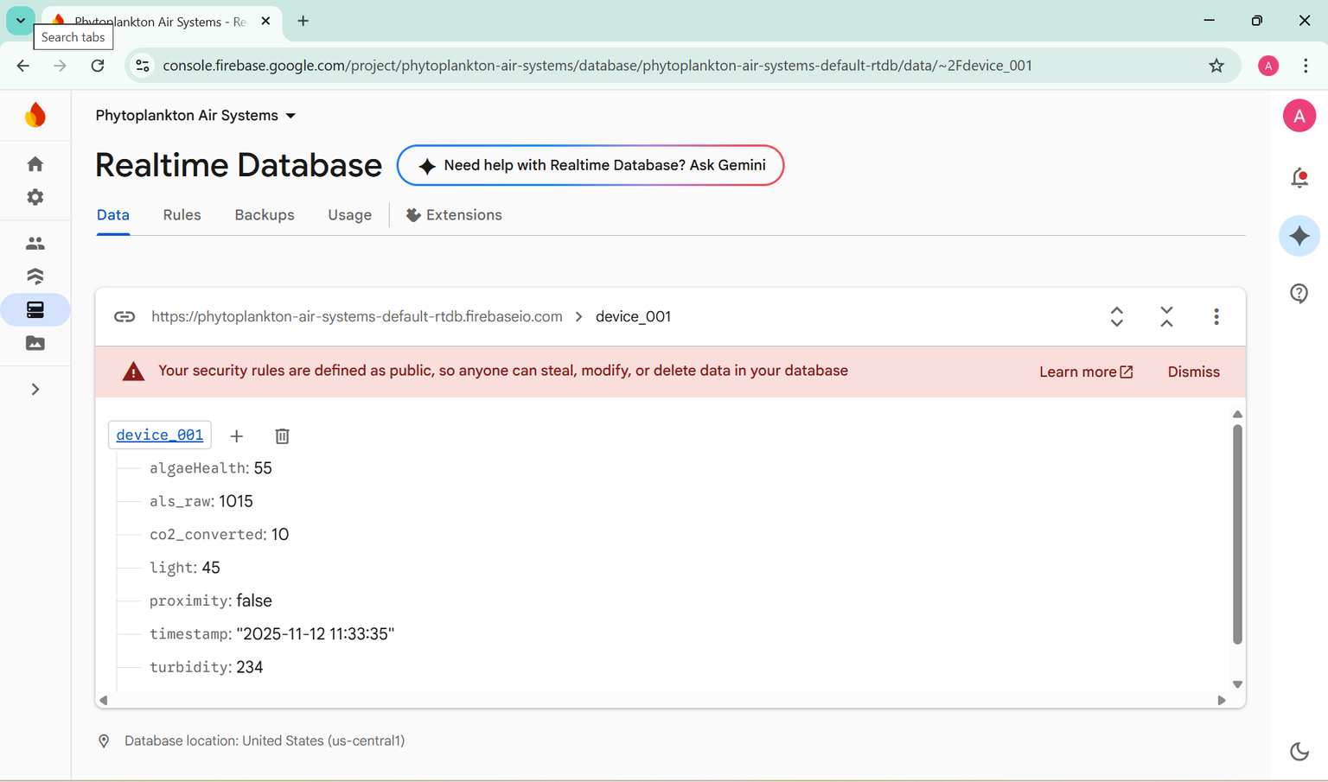
Cloud Database & Backend Structure
The system uses Firebase to store and manage all sensor data and user information.
Realtime Database holds live environmental readings—air quality, light, proximity, and turbidity—sent continuously from the Raspberry Pi.
Data is uploaded using Firebase’s SDK for fast, synchronized updates with the mobile application.
Firebase Authentication securely stores and manages user login credentials.
All device data is organized under a dedicated data path, allowing the mobile app to retrieve and visualize values instantly.
The backend supports multi-screen functionality including the Dashboard, Leaderboard, and Insights views.

Slide 5
Mobile Application – Real-Time Monitoring & User Interface
Android application built to display all live sensor readings sent from the Raspberry Pi.
Secure Firebase Authentication allows users to log in with stored credentials.
App retrieves real-time values from the Realtime Database (e.g., algaeHealth, light, turbidity, proximity, CO₂ converted, timestamp).
Dashboard Screen shows current environmental values in a clean, user-friendly layout.
Leaderboard – compares users based on captured CO₂ metrics
Insights – displays weekly/monthly performance trends
Provides an educational and interactive experience by visualizing environmental changes instantly.

Slide 6
Demonstration Setup – 3D Printed Enclosure & Hardware Integration
System housed in a custom 3D-printed enclosure holding the Raspberry Pi 4, PCB, wiring, and all sensors.
Enclosure includes individual compartments for sensors to improve airflow and stable placement.
3D-printed design provides clean cable management and protects components during demos.
Sensors connect via Qwiic connectors for quick swap, maintenance, and reliability.
Custom PCB replaces the breadboard for reduced wiring errors and better stability.
Raspberry Pi streams real-time data (air quality, light, proximity, turbidity) to Firebase, displayed instantly in the mobile app.
Compact setup demonstrates smooth hardware integration and live data flow end-to-end.

Slide 7
DEMO

Slide 8
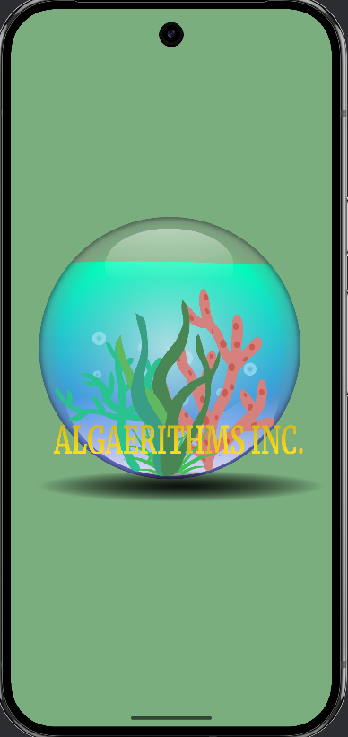
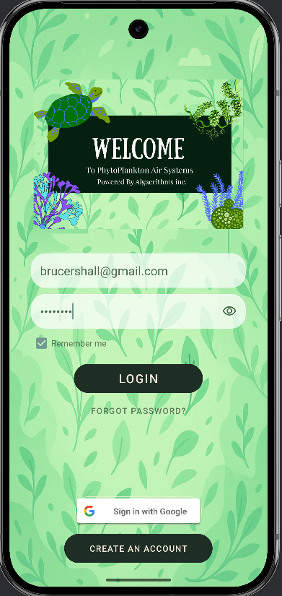
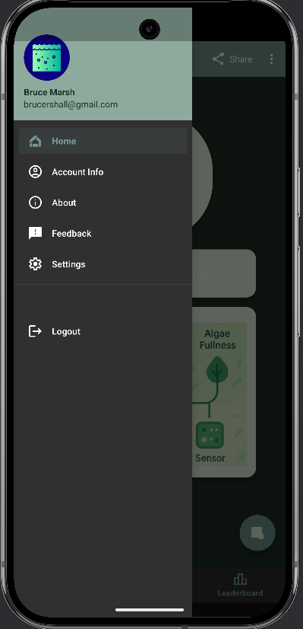
Glimpse Of the App

Slide 9
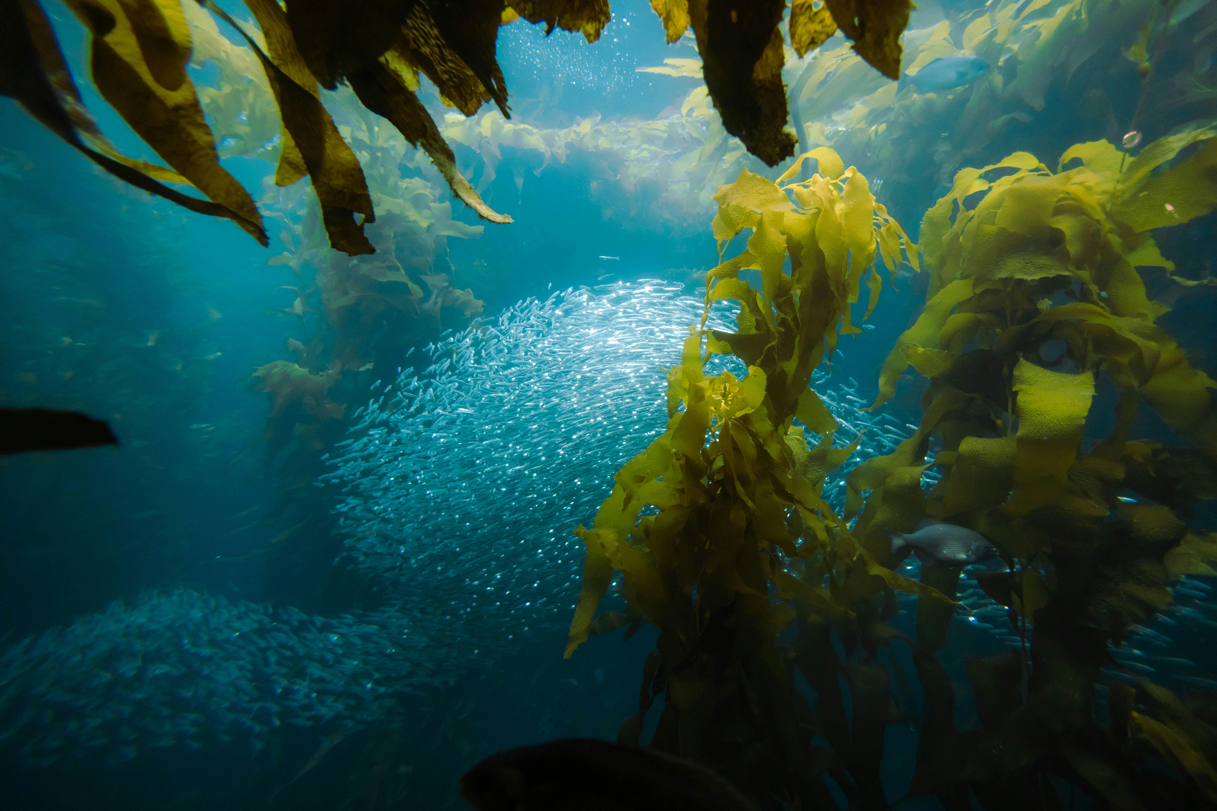
Why Our Project Breaks the Mold
Our project goes beyond typical app development — we integrated a real algae system to bring biology and tech together. We built for impact, not just function, adding a climate education screen, gamified tracking, and real-world service features. Every detail, from reusable algae pods to user-focused design, was made to create a product that’s sustainable, engaging, and built to last.
Notes:
Most capstone apps simulate features — we built a system that’s alive.
We combined tech with biology and education.
It’s not just functional — it teaches, motivates, and supports real action.
Everything from algae reuse to user flow was designed for real-world use.

Slide 10
CENG322 Software Project
Thank you
Algaerithms Inc.

